Slide 1
Capstone Project
Mahmoud A. Kholif
Colorado State University Global
MIS 581: Capstone - Business Intelligence and Data Analytics
Dr. Kimberly A. Ford
November 7, 2021

Slide 2

Notes:
Quintess Collections believes in “bringing families and friends together, under one roof, in luxury vacation homes around the world - to gather and play in beautiful spaces, and to create memories that will live on forever” (Quintess Collections, 2021).

Slide 3

Overview of the Study
Notes:
As a travel company, the travel restrictions put in place at the height of COVID-19 significantly impacted the company's financial outlook. With travel beginning to resume, the company is looking to business intelligence and data analytics to provide insight that will help growth and future revenue.

Slide 4

Study Objective
Notes:
As Quintess is looking forward to increasing revenues to recover from the significant financial loss that occurred due to COVID, all stakeholders are looking towards the data for information that will help guide strategic decisions as well as promote stability and growth for the company. Through looking at past data trends, forecasting future revenue opportunities, and providing insight and recommendations based upon historical data, this study strives to address the complex organizational needs of Quintess Collections through a quantitative research approach.

Slide 5
Quintess Collections vs. Airbnb
Airbnb launched in 2008
Quintess launched in 2004
Quintess Collections, while being a travel company, does have significant differences from other travel companies that are leading competitors such as Airbnb.
Extensive homes
Wealthier Clientele
Notes:
Quintess Collections, while being a travel company, does have significant differences from other travel companies that are leading competitors such as Airbnb. Airbnb launched in 2008, four years later than Quintess, with 1.5 million listings across 34,000 cities. Even though Airbnb is a fast-growing business with an extensive home's portfolio selection (Deane, 2021), Quintess Collections is still in business because of its travel experience that exceeds the needs and expectations of each market segment with the highest level of quality. Competitors like Airbnb provide travel experiences for clients at a greater range of price point and service levels. Conversely, Quintess Collections targets a wealthier clientele, and the standard of service matches the higher price point. The service standards are rendered by each service partner and offer a complete portfolio of high-end accommodations, including luxury resort villas, private residences, and five-star hotels and resorts across multiple industry market segments. The higher price point of Quintess Collection properties, and the significant downturn in the economy from COVID-19, have contributed significantly to a bleak financial outlook for Quintess Collections.

Slide 6
Hospitality Businesses and COVID-19
Non-Financial
Customers
Resource Utilization
Market Orientation
The hospitality Business has numerous circumstances that impacted business performance significantly before the COVID travel ban.
Notes:
The hospitality Business has numerous circumstances that impacted business performance significantly before the COVID travel ban. Phan et al. (2021) argued that non-financial factors that influence the hospitality business, such as the quality of services, the level of compliance the company can offer to customers, resource utilization, and market orientation, have a vital role in determining profitability. The study further explored hotels located in Vietnam and incorporated evidence that directly and indirectly impacted the effects of the non-financial factors.

Slide 7
RESEARCH
QUESTIONS
Question 1:
What was the financial impact of COVID travel restrictions on revenues made for the top five Quintess destinations?
Question 2:
Which Quintess destinations had the most significant decline in bookings in the last 24 months?
Question 3:
What is the effect of extending contracts to add availability for bookings on reservation percentages?
Notes:
Through looking at past data trends, forecasting future revenue opportunities, and providing insight and recommendations based upon historical data, this study strives to address the complex organizational needs of Quintess Collections through a quantitative research approach. Focusing on the following three questions, this study seeks to create recommendations for Quintess that will support the company growth goals:

Slide 8
NULL HYPOTHESIS
Extending contracts to add availability for bookings has no impact on reservation percentage.
H0: μ ≤ 20%
HYPOTHESIS
ALTERNATIVE HYPOTHESIS
Extending contracts to add availability for bookings has an impact on reservation percentage.
H0: μ > 20%
Notes:
The hypothesis of this study is as follows: Extending contracts to add additional availability for bookings for the highest-demand destinations (San Diego, Wine Country, Orlando, Costa Rica, and Charleston) will increase reservations by twenty percent, resulting in increased revenue for Quintess Collections.
Through this hypothesis, this study seeks to determine the relationship between the independent variable, the extended contract for each property to add availability for bookings, and the dependent variable, or outcome variable, which is the number of reservations made to establish causality.

Slide 9
RESEARCH DESIGN
Data sets
Causal Comparative Approach
Methodology
Notes:
Through looking at past data trends, forecasting future revenue opportunities, and providing insight and recommendations based upon historical data, this study strives to address the complex organizational needs of Quintess Collections through a quantitative research approach.
Datasets
Within a quantitative research design, there are numerous sources of data and variables that can be used to gain insight. In designing the study, it is important to keep in mind that the analysis of data is not the only important aspect of a quantitative study. The most important part of setting up a quantitative study, according to Sukamolson (2017), is identifying the correct data source and collection instruments.
With this data focus in mind, this study may best be approached through causal-comparative research, as it requires an investigation of a precise problem that has already been identified (COVID travel restrictions), and an in-depth evaluation of the effect of the situation (Apuke, 2017).
Causal-Comparative Research Approach
This study intends to examine data from the previous twelve to twenty-four months to determine the relationship between extending the contracts by allowing more available nights and the nights booked.
With this data focus in mind, this study may best be approached through causal-comparative research, as it requires an investigation of a precise problem that has already been identified (COVID travel restrictions), and an in-depth evaluation of the effect of the situation (Apuke, 2017).
Methodology
According to Creswell and Creswell (2018), “quantitative research is an approach for testing objective theories by examining the relationship among variables” (p. 4). Quantitative research is suitable for this study about Quintess Collections as it requires an in-depth analysis of reservation, cancellation, and arrival data.

Slide 10
Methods
Data Collection
Validity
Reliability
Data Analysis
Privacy
Ethical Considerations
Security
Limitation
Notes:
Data Collection
There are many data collection methods and tools that can be used in quantitative research. To begin with, historical data will need to be identified within the Sunshine data warehouse in order to acquire the data needed to test the hypothesis.
Data Analysis
There are many techniques to use for analyzing data to select, and they all work for the potential outcome analysts are hoping to achieve (Stevens, 2011). The Summary Statistics is a common step to summarize and provide information about the dataset. Clustering the data will help to identify the market segments among the distribution channels.
Limitations
While all attempts are being made to create a comprehensive look at the impact of COVID 19 on Quintess reservations and the extent to which increasing availability encourages reservations, this study is limited by the data that will be used in the study. As this study primarily targets data sets from the previous 24 months, it is inherently limited by its ability to acknowledge Quintess Collection growth patterns for the years prior to COVID-19.
Ethical Considerations
This study strives to create recommendations following an investigation of the data that will answer the primary research questions and test the hypothesis of the study. To ensure that the data that results from this study is accurate and meaningful, it is important to consider the ethical implications of the study, including identifying ways to ensure the validity and reliability of the project. A study that does not ensure validity and reliability will not produce beneficial results.
Validity
The concept of validity in quantitative research refers to the extent to which a topic is accurately measured and looks at how comprehensive the data and analysis are with respect to the variables (Heale & Twycross, 2015).
Reliability
The concept of reliability in quantitative research refers to the consistency of the results (Heale & Twycross, 2015) obtained through “repeated measurements under the same circumstances using the same measuring instrument” (Sürücü & Maslakçı, 2020, p. 2695).
Security
Security within quantitative research refers to all security measures taken within the data collection and analysis process (Maayan, 2020). In addition, Davix and Patterson (2012) explained that security also refers to the security of the data as it moves through each entity in a data chain (p. 25).
Privacy
Discussions about privacy, specifically in relation to big data, are also critical to consider as personal information about individuals is more readily available through open access to data as well as the degree of control individuals have over their data given to private entities (Davis & Patterson, 2012).

Slide 11


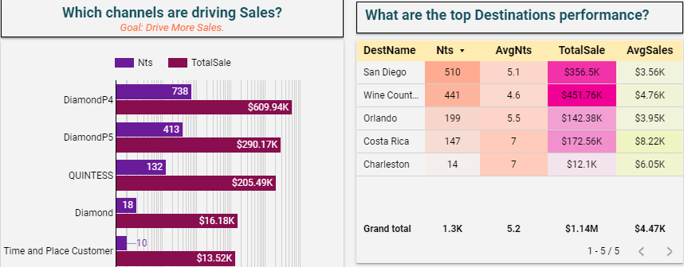
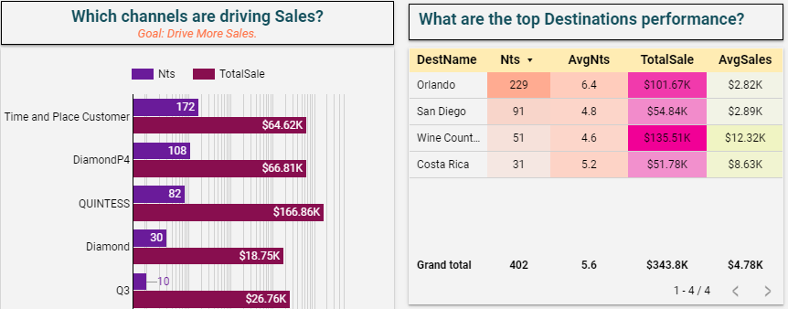
Findings Before & During COVID-19
Notes:
The findings of this study will be presented based upon the primary research questions guiding this study. The reporting of the findings regarding the hypothesis will be included in the discussion about the third research question.
The dataset range fell between March 2019 to March 2020, the date most travel restrictions were established. The top five destinations were San Diego, Wine Country, Orlando, Costa Rico, and Charleston. sales were very high in all destinations except Charleston, which had below average sales. Despite not having high sales prior to the travel ban, Charleston was included as it became a top destination following COVID travel restrictions.
The dataset pulled for the twelve months following the implementation of travel restrictions, there is a stark difference in the leading channels driving sales, and the top destinations. First, in looking at the top channel driving sales, Diamond P4 is no longer the leader. Time and Place Customer bookings exceeded the bookings. This is likely because Time and Place reservations are most used for domestic travel in more economical destinations, as opposed to high end luxury destinations.

Slide 12
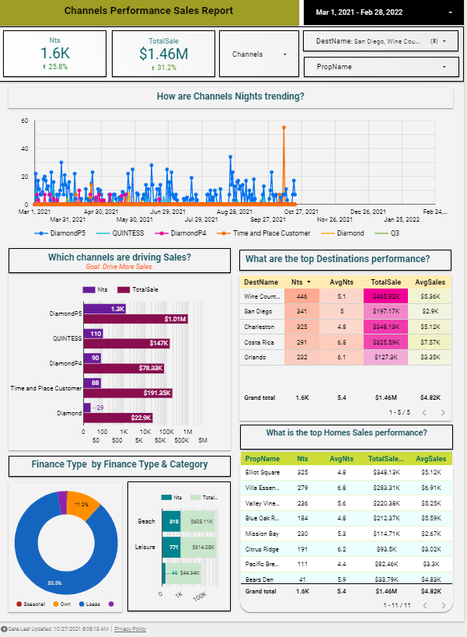
Findings After COVID-19 Travel Ban Lifted
Notes:
Utilizing the current booking data and creating a visualization graph to present the booked nights as of March 1st, 2021, we can see that there is a percentage increase in the nights booked which is up to 25.8% compared to the same period last year.

Slide 13

Conclusions
Notes:
In comparing the means of the booked nights between the datasets before and during the Covid travel restrictions were put into place, there was an average difference of 5.13 and a p-value of 0.02443. This means that the null hypothesis can be rejected. This means there is no difference between average nights and conclude that there is likely a difference in average booked nights before and after the Covid travel ban.

Slide 14

Recommendation
Notes:
Due to the Covid travel ban, The Quintess collection had a significant loss in making reservations.
Despite this significant loss in reservations, properties such as Charleston had an unexpected rise in reservations and became a top contender against much more prominent destinations prior to COVID.
With this information in mind, it appears that domestic destinations in the mainland United States fared better despite travel restrictions.
As the Arrivalist (n.d.), a public daily travel index also alludes, local destinations are thriving.
As a recommendation, stakeholders should consider adding additional local destinations that are within driving distance for members.

Slide 15

Conclusions
Notes:
Apuke, O. D. (2017). Quantitative research methods: A synopsis approach. Arabian Journal
of Business and Management Review (Kuwait Chapter), 6(10), 40-47.
Arrivalist. (n.d). Daily travel index. Retrieved October 20, 2021 https://www.arrivalist.com/Daily-Travel-index/
Cohen, D., & Crabtree, B. (July 2006). Audit Trail. Qualitative Research Guidelines Project.
http://www.qualres.org/HomeAudi-3700.html
Creswell, J. W., & Creswell, D. J. (2018). Research design: Qualitative, quantitative, and
mixed methods approaches. (5th edition). Sage Publications, Inc.
Davahli, M. R., Karwowski, W., Sonmez, S., & Apostolopoulos, Y. (2020). The hospitality
industry in the face of the COVID-19 pandemic: Current topics and research methods. International Journal of Environmental Research and Public Health, 17(20). https://doi.org/10.3390/ijerph17207366
Davis, K., & Patterson, D. (2012). Ethics of big data. O’Reilly Media.
Deane, S. (January 26, 2021). 2021 Airbnb statistics: Usage, demographic, and revenue growth.
Stratos Jet Charters, Ind. https://www.stratosjets.com/blog/airbnb-statistics/
Dietrich, D., Heller, B., & Yang, B. (2015). Data science & big data analytics: Discovering, analyzing, visualizing, and presenting data. John Wiley & Sons, Inc.
Farrugia, P., Petrisor, B. A., Farrokhyar, M., & Bhandari, M. (2009). Research questions, hypotheses and objectives. Canadian Medical Association, 53(4), 278 - 281.
Hand, D. J. (2018). Aspects of data ethics in a changing world: Where are we now? Big Data,
6(3), 176-190. http://doi.org/10.1089/big.2018.0083
Hariri, R. H., Fredericks, E. M. & Bowers, K. M. (2019). Uncertainty in big data analytics:
Survey, opportunities, and challenges. Journal of Big Data, 6(44), 278 - 281.
https://doi.org/10.1186/s40537-019-0206-3
Heale, R., & Twycross, R. (2015). Validity and reliability in quantitative studies. Evidence Based
Nursing, 18(3), 66-67. https://ebn.bmj.com/content/ebnurs/18/3/66.full.pdf
Hellerstein, J. M. (2008). Quantitative data cleaning for large databases. United Nations
Economic Commission for Europe (UNECE). UC Berkeley. https://dsf.berkeley.edu/jmh/papers/cleaning-unece.pdf
Lantz, B. (2019). Machine learning with R: Expert techniques for predictive modeling (3rd ed.).
Packt Publishing.
Maayan, G. D. (2020). Big data security: Challenges and solutions. DATAVERSITY.
https://www.dataversity.net/big-data-security-challenges-and-solutions/#
Manyika, J., Chui, M., Brown, B., Bughin, J., Dobbs, R., Roxburgh, C., & Hung Byers, A.
(2011, May 1). Big data: The next frontier of innovation, competition, and productivity. McKinsey Global Institute. https://www.mckinsey.com/business-functions/mckinsey-digital/our-insights/big-data-the-next-frontier-for-innovation
Marr, B. (2016). Big data: How 45 successful companies used big data, analytics, and metrics to
make better decisions and improve performance. John Willey and Co.
Stevens, E. (2021, October 1). The 7 most useful data analysis techniques. Career Foundry.
Retrieved from https://careerfoundry.com/en/blog/data-analytics/data-analysis-techniques/
Sukamolson, S. (2017). Fundamentals of quantitative research. Chulalongkorn University Language Institute. (pp. 1-20). Retrieved from http://carinadizonmaellt.com/LANGRES/pdf/30.pdf ​​
Phan, T. K., Nguyen, T. H. T., Dang, T. H., & Le, K. N. (2021). Non-financial factors affecting
the operational performance of hospitality companies: Evidence from Vietnam. Problems and Perspectives in Management, 19(4), 48. https://www.businessperspectives.org/images/pdf/applications/publishing/templates/article/assets/15690/PPM_2021_04_Phan.pdf
Quintess Collections. (n.d.). Quintess Collections. Quintess. Retrieved October 1, 2021, from
https://quintess.com/
Sürücü, L. & Maslakçı, A. (2020). Validity and reliability in quantitative research. Business &
Management Studies: An International Journal, 8(3), 2694-2726. http://dx.doi.org/10.15295/bmij.v8i3.1540
Van Rensburg, L. C. (2015). The financial impact of environmental management on operations
in selected hotels in Cape Town South Africa (Doctoral dissertation, Cape Peninsula University of Technology). http://ir.cput.ac.za/bitstream/20.500.11838/1615/1/203043553_van_rensburg_lc_mtech_tourism_2015.pdf

